Slide 1
Part 13: Capsule Network
Presented By: T.E. Shree Ram Khaitu

Slide 2
Content
Capsule nets basics

Slide 3
Why Capsule Nets
CNN are translation invariant
CNN requires alot of data to generalize features
CNN are bad representation system of HVS
Routing Mechanism is not present in CNN

Slide 4
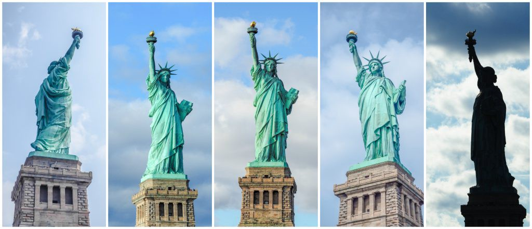

Slide 5
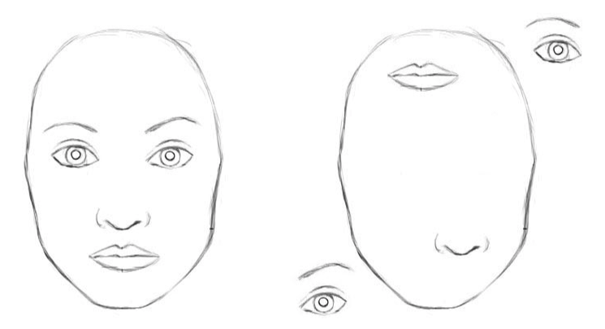

Slide 7
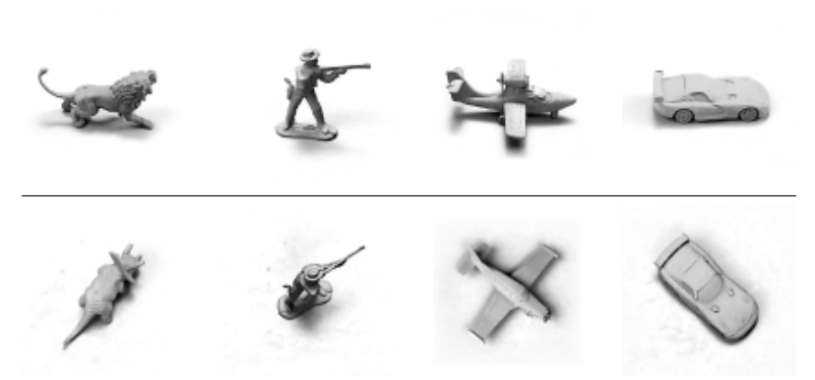

Slide 8
Capsule
Group of neurons representing varius properties
Ouput’s a vector (m and ⊖)

Slide 9
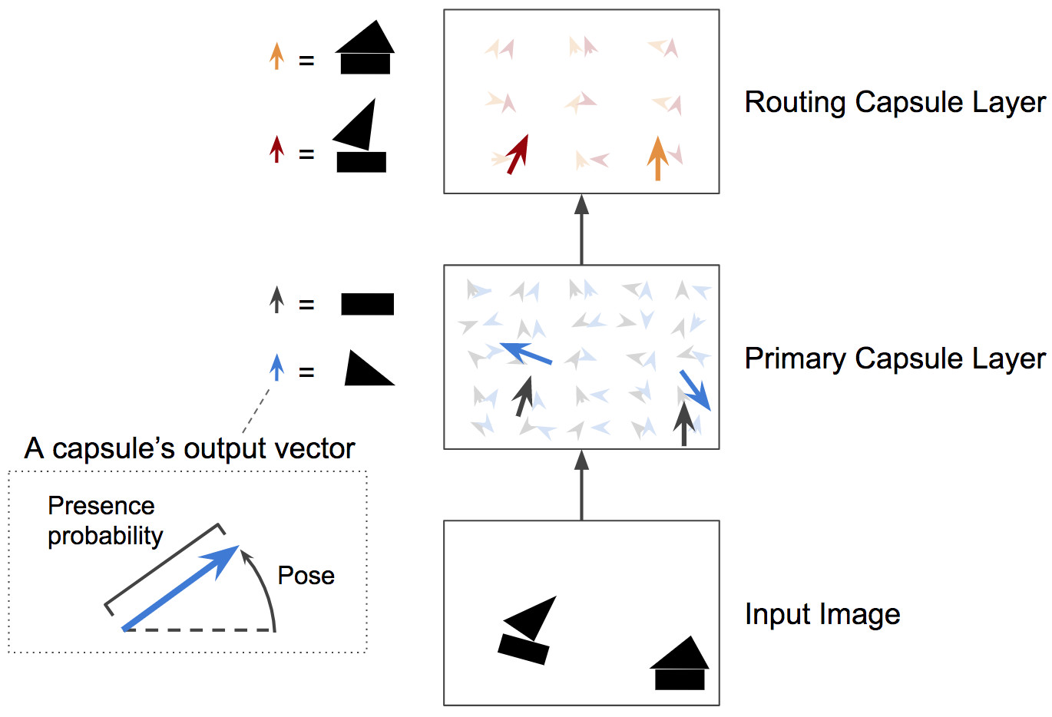

Slide 10
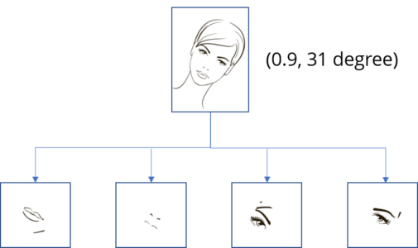

Slide 11
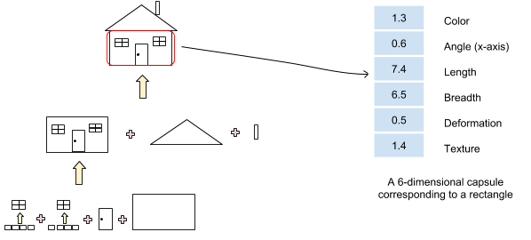

Slide 12
Dynamic Routing

Slide 15
Squashing

Slide 16
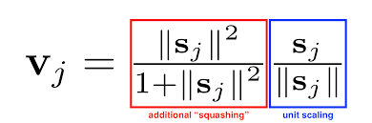

Slide 17
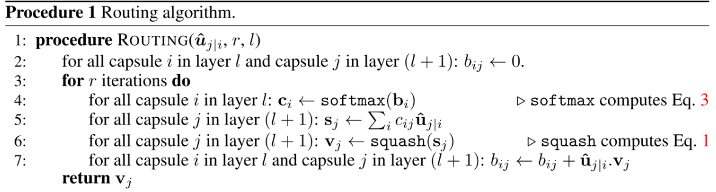

Slide 18
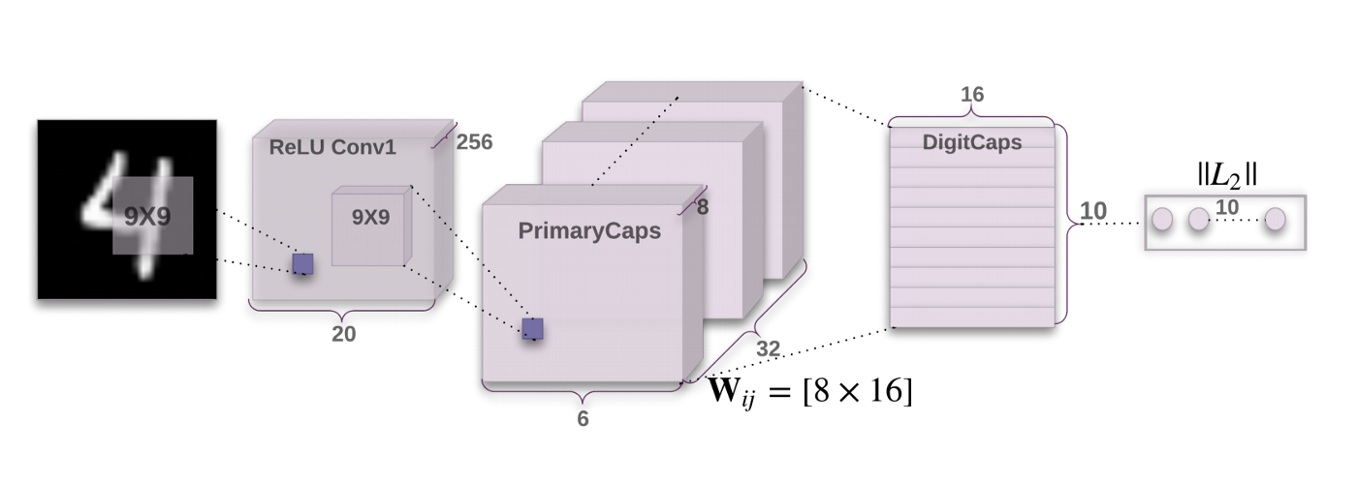
Architecture

Slide 19
Convolution Layer

Slide 20
Primary Cap layer

Slide 22
Digicap layer

Slide 23
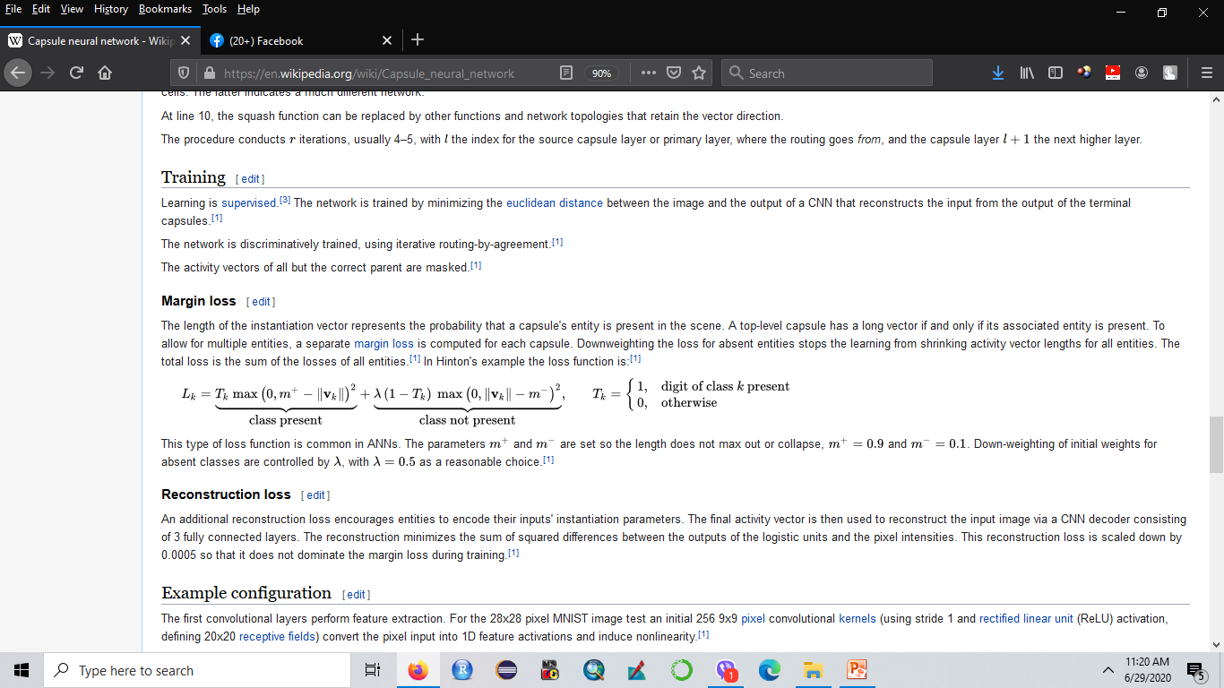
Margine Loss

Slide 24
